Slide 1
The Insurance Ramifications of Climate Change – Australia
AIDA Climate Change and Catastrophe Working Party Meeting – Marrakech - April 2019

Slide 2

Australian Rainfall data -2018

Slide 3
Australian Temperature data - 2018

Slide 4
Frequency of Bush fires – 2018

Slide 5
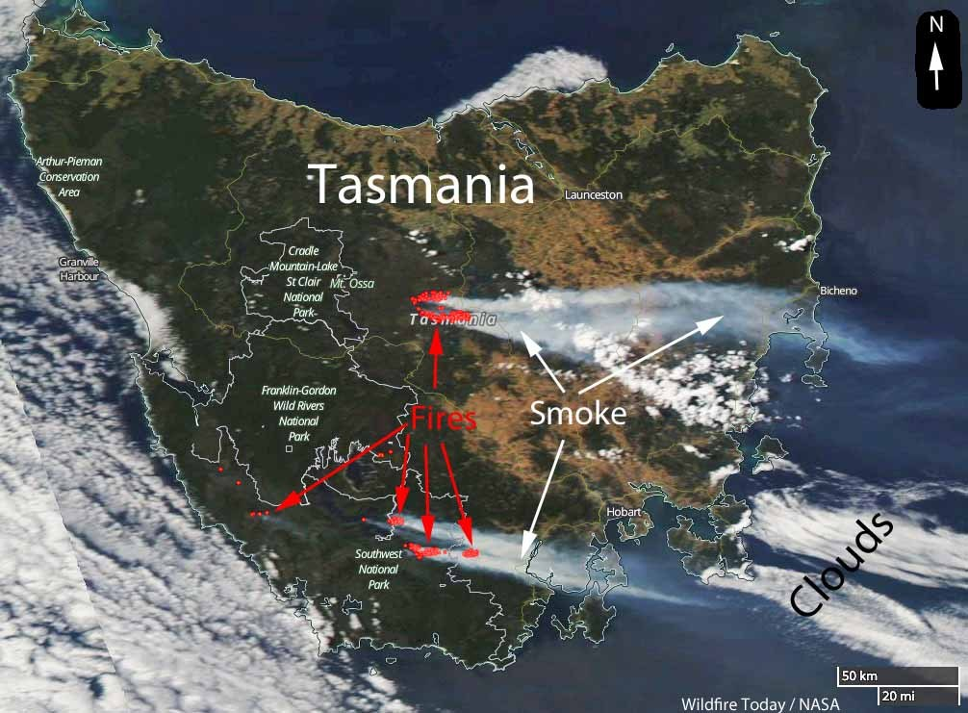
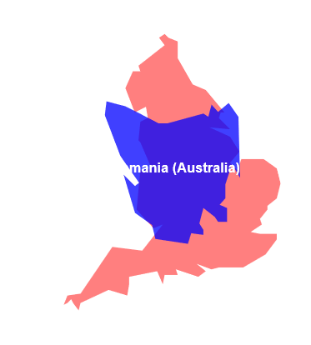

Slide 6
Australian Actuaries Climate Index ( AACI)
Developed to measure whether the frequency of extreme weather conditions is changing over time.
Designed to assist actuaries , public policy makers , companies , insurers and the general public about climate trends in Australia.
Index finalised and released in November in 2018.
The index created as a result of data provided by the Australian Department of meteorology over a 30 year period from 1981 – 2010.
The index examines changes in frequency and duration of extreme events and is based on a similar Climate Index operating in the USA .
The focus is on extremes which are related to risks such as inland and coastal flooding , cyclones , drought & heatwaves.

Slide 7
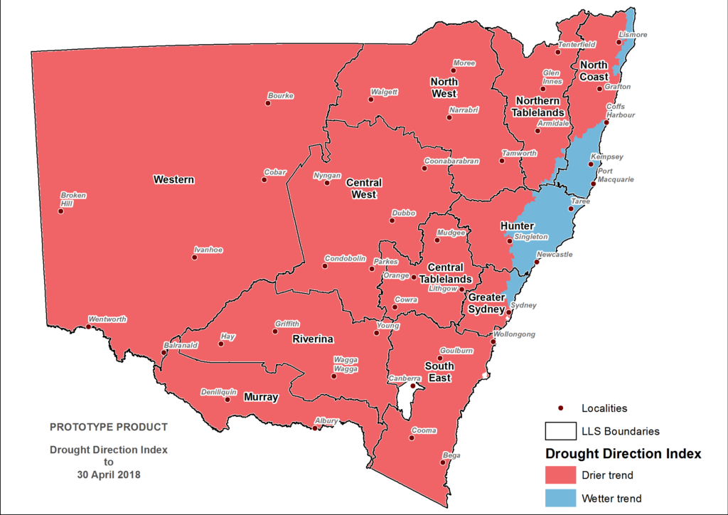
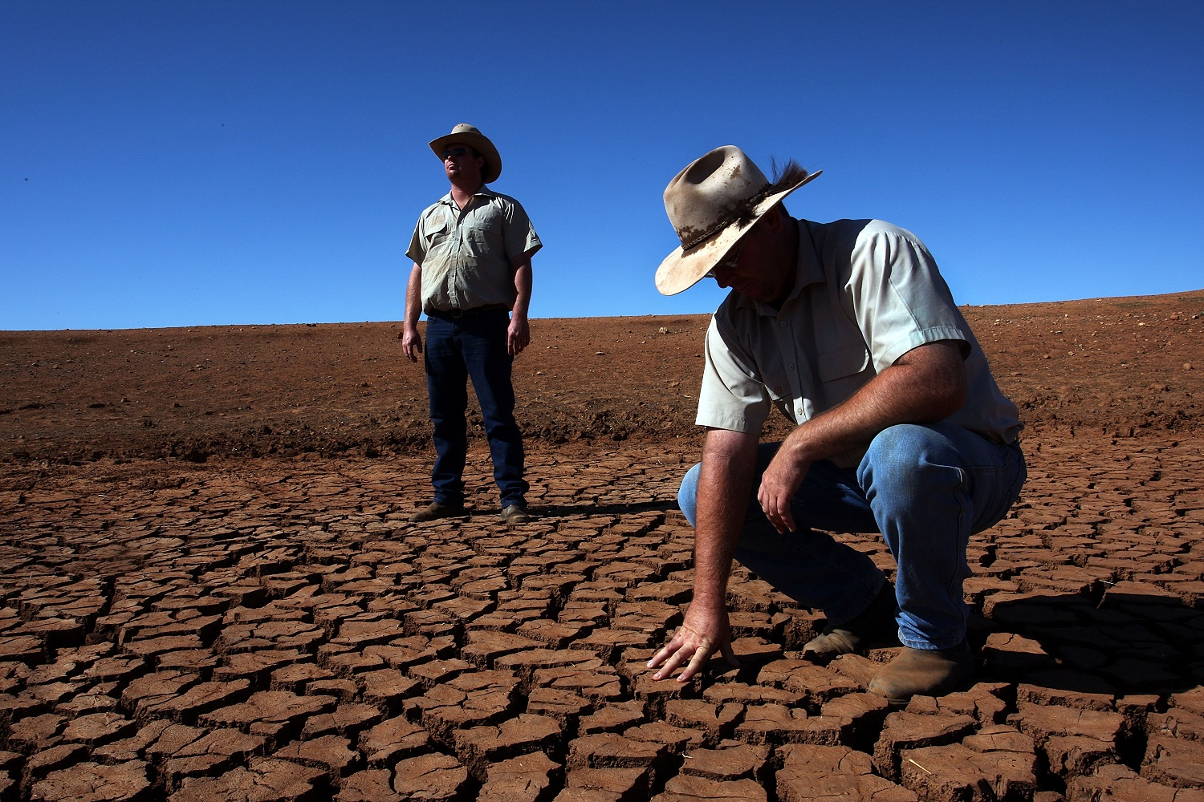
2018 NSW drought

Slide 8
Headline indicators – Regional differences

Slide 9
National Environmental Indicators : Change from 2017 ( Australian environment website )

Slide 10
The Climate Change Index
Examines data re frequency and duration of – Extreme temperatures ( high and low separately ) , heavy rainfall , drought , changes in sea level and strong winds.
The index is available for 12 regions in Australia with each index time line commencing in 1981.
The data examines each meteorological season ( summer, winter , autumn and spring ) with a 5 year moving average as a key metric.
The results are produced for each season such that each season is compared with the prior years season.
Temps measured from 112 Acorn- Sat Stations. Rainfall - 2000 stations, Wind – 38 stations and sea level from 16 tide gauges around Australia.

Slide 11
The index is available to the public
The index is freely available to the public to enable home owners and business to access the data to evaluate zonal risk factors.
It is not site specific, with the focus on zonal or regional risk.
Also assists insureds or potential insureds to more fully understand the basis upon which insurers, price and evaluate, risk.
It is merely a tool.. Clearly not solution!

Slide 12
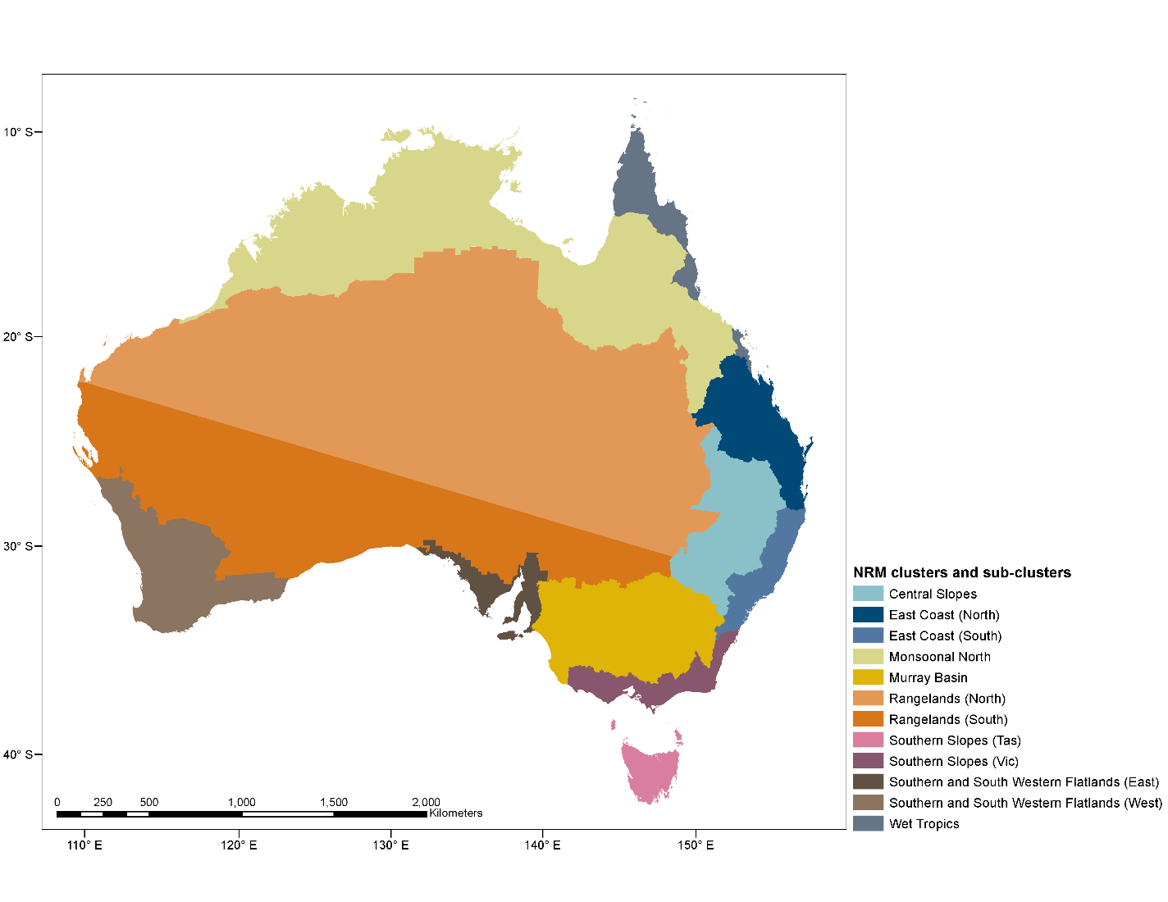
The Regional Map

Slide 13
The High Risk Zones are increasing
The frequency of severe weather related events is rising faster in some zones than others – for example ….
The frequency of extreme hot days has increased 177% in the Central Slopes of the eastern states but only 34%in Tasmania’s Southern Slopes.
Sea levels have risen 11.3 cm in the East Coast ( North ) region of Queensland but only 2.1cm on the Southern and South western Flat lands of Western Australia’s southern coastline.
Wind velocity and intensity varies between regions – strong winds 65% more common in the Central Slopes ( Central NSW) but 55% less frequent in the Southern and South Western Flat lands ( of SA).

Slide 14
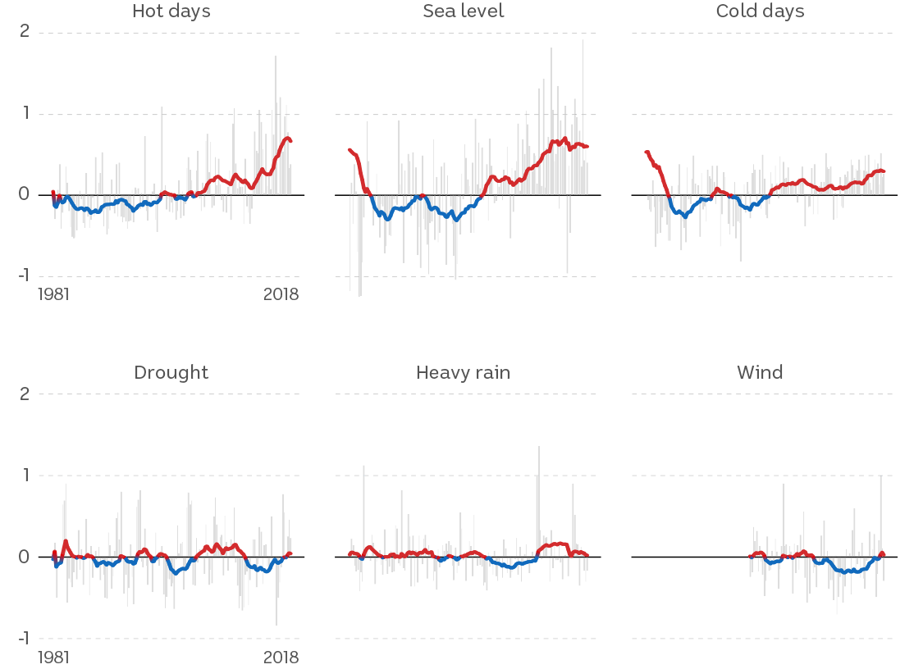

Slide 15
Climate change trends
Sea levels are rising and extreme temperatures are becoming more common across Australia.
January 2019 was the hottest month ever recorded in Australia – mean temp across the country exceeded 30 degrees C. Adelaide, the capital of South Australia, recorded a record temp for an Australian capital city of 46.2 C.
Hottest March on record – mean national temperature ,2.13 degrees above average.
Australia- wide, extreme hot days are now 80% more common and extreme cold days are 74% LESS common than the long term average.
Maximum sea level has risen 5.9 cm.
Wind and rain show now clear pattern up or down.

Slide 16
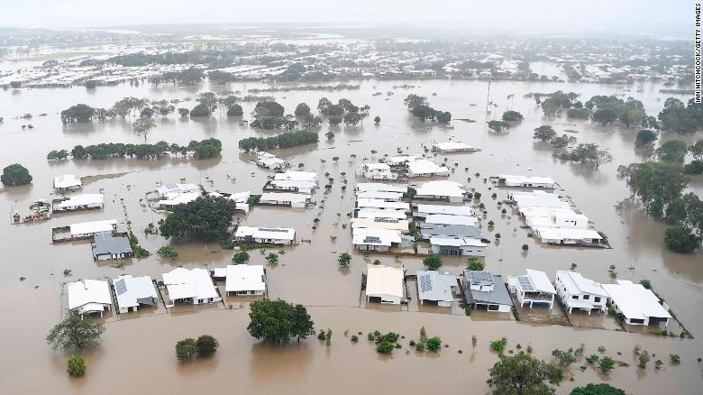

Slide 17
…the consequences & the insurance challenge
Based on current projections ,approximately 850,000 homes, or nearly 10% of all residential properties will , by 2100 , become uninsurable.
“Uninsurable” is defined as those where the annual premium would exceed 1% of the property value . This figure is approximately 220, 000 more than 2018.
Examples – flood risk in Townsville ( Queensland ) which was recently subject to cyclonic induced flooding . Insurers currently use 1/100 year flood zone data to set boundaries for high risk .By the end of the century that risk will have increased by 130% . Expressed in another way , what used to be in a 1/200 year flood zone , will then be the new 1/100 zone.
Based on property value, such homes would be uninsurable.

Slide 18
Building codes and zoning restrictions
Where mitigation strategies are in place, experience indicates lower premiums – examples include housing construction with greater fire resilient materials . Homes constructed according to cyclone codes, flood levy banks , limiting construction of dwellings in flood prone areas or areas subject to storm surge.
Current problem is that generally the insurance industry in Australia is nor involved in setting building codes.
People in high risk zones currently face unaffordable premiums.
To secure a mortgage prospective home owners are required to take out insurance. If they decline to do so, finance will not be granted….

Slide 19
The financial risk ….Where does it fall?
…… but while the mortgage requires the maintenance of insurance, many decline to renew and the banks generally do not check for continuity of insurance.
If a property becomes uninsurable it is effectively impossible to sell it , because the purchaser will not be able to secure insurance.
Failure to maintain insurance involves both a risk to the owner and the financial institution.
In the event of loss or damage and the absence of adequate insurance the burden is often shifted to public charity or governments ( state and or federal). Examples – the bush fire levy in Victoria and government payouts in Queensland following the recent Townsville floods.

Slide 20
The index is not a solution for affordability
The index enjoys the support of the Australian financial regulator APRA ( Australian Prudential Authority) as it aids industry , corporations , Financial services providers etc in assessing risk.
Certainty and continuity of cover remains an issue – Insureds need to know that insurance coverage will be both available and affordable for the duration of their mortgage . Based on the index projections it is unlikely insurers can provide such a guarantee .
Coast regions along the East coast ( NSW and Queensland) remain particularly vulnerable to storm surge damage , coastal flooding and sea level rise

Slide 21
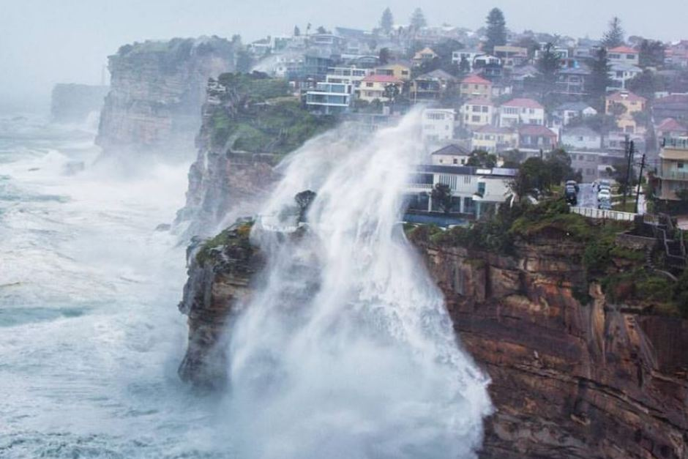
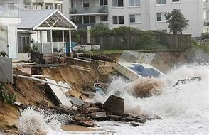
NSW Coastal storm damage

Slide 22
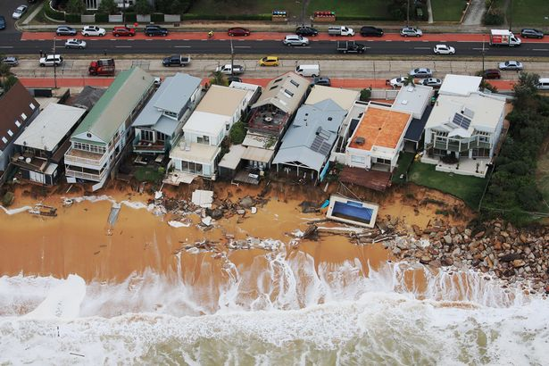
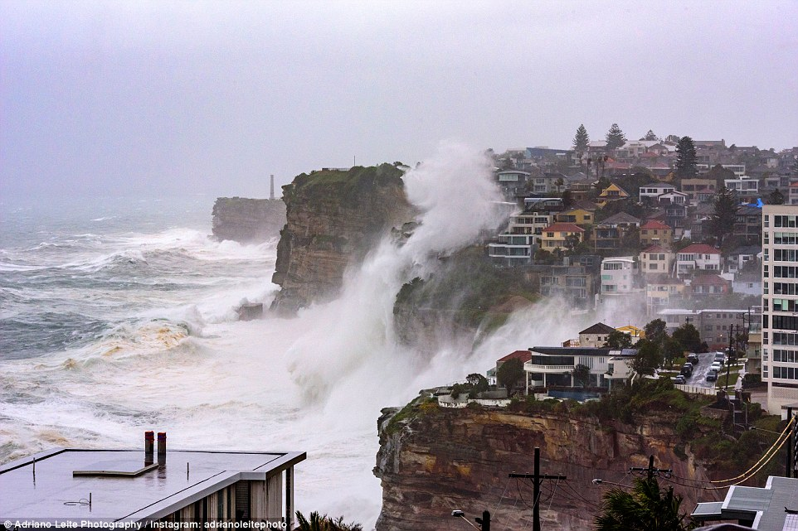
…….Storm surge and coastal inundation

Slide 23
The Politics of climate change- voter priorities
2016
Environment – 9%
Economy – 25%
Health Care -16%
Education – 12%
Superannuation & pensions -12%
Immigration & refugees - 9%
2019
Environment – 29%
Economy – 23%
Healthcare – 8%
Education - 5%
Superannuation and pensions – 8%
Immigration & refugees – 6%

Slide 24
The politics of climate change in Australia
Of the undecided voters ,a survey in April confirmed that 30% , place environmental issues as their key election issue.
… with a federal election to be held before the end of May 2019, it will be interesting to see how the political parties , other than the Greens Party, tackle Australia’s increasing vulnerability to climate change related risks.
If prior elections are any guide many promises will be made but few will be kept !

Slide 25
